Slide 1



PSAS Electric Propellant Feed System
Affiliations: ¹Portland State Aerospace Society, ²Maseeh College of Engineering and Computer Science Portland, OR, 97201, United States

Slide 2
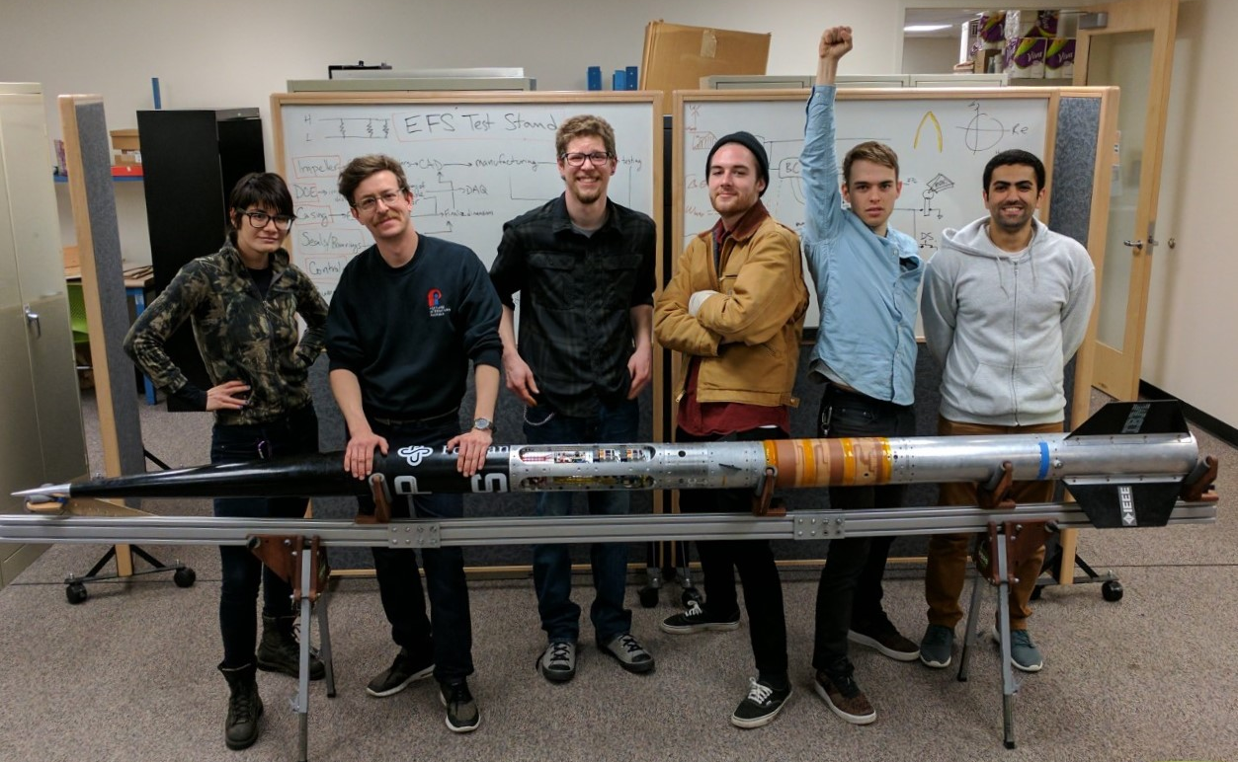
The Team
Team Members (left to right):
Mimi Shang, James Luce, Jorden Roland, Johnny Froehlich, Johnathan Talik, Rawand Rasheed

Slide 3
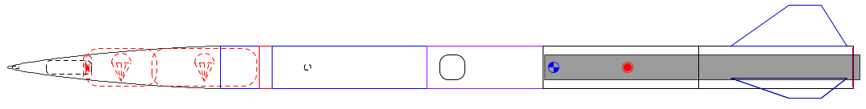

The Problem
Portland State Aerospace Society (PSAS) wants its rockets to go higher, but mass is the enemy:
Δv = change in velocity
V_{e} = exhaust velocity
m_{o} = mass of rocket + propellant
m_{f} = mass of rocket

Slide 4
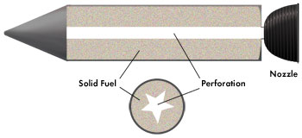
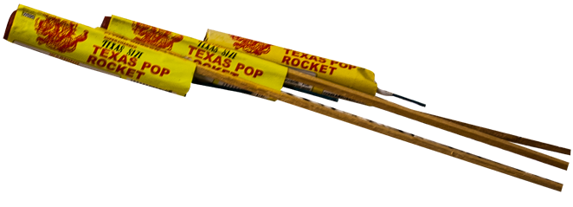
Past approach: solid propellant
Most small rockets use solid propellant.
Simple but inefficient.
Can’t throttle = can’t insert into orbit.
Solid propellant
Nozzle
Grain bore
Solid propellant rocket design
Solid propellant rocket example
Images: http://www.fireworkssupermarket.com, http://www.aerospace.org

Slide 5
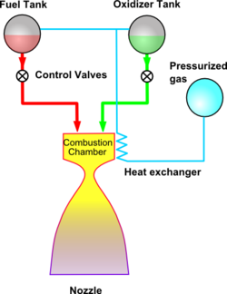
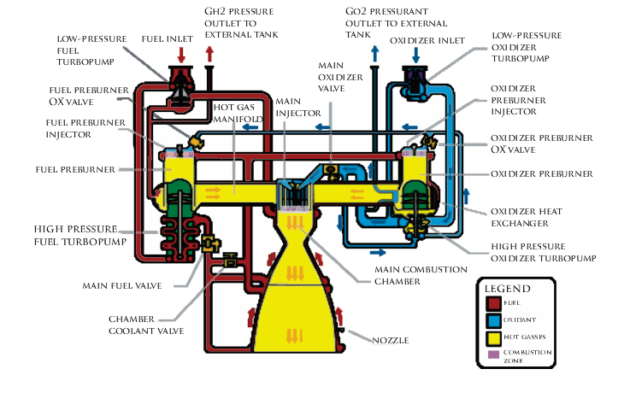
Liquid propellant
Gives more Δv for its mass = goes higher.
Can be throttled = can insert into orbit.
Pressure fed: too heavy
Turbopump: too complex
Images from wikipedia

Slide 6
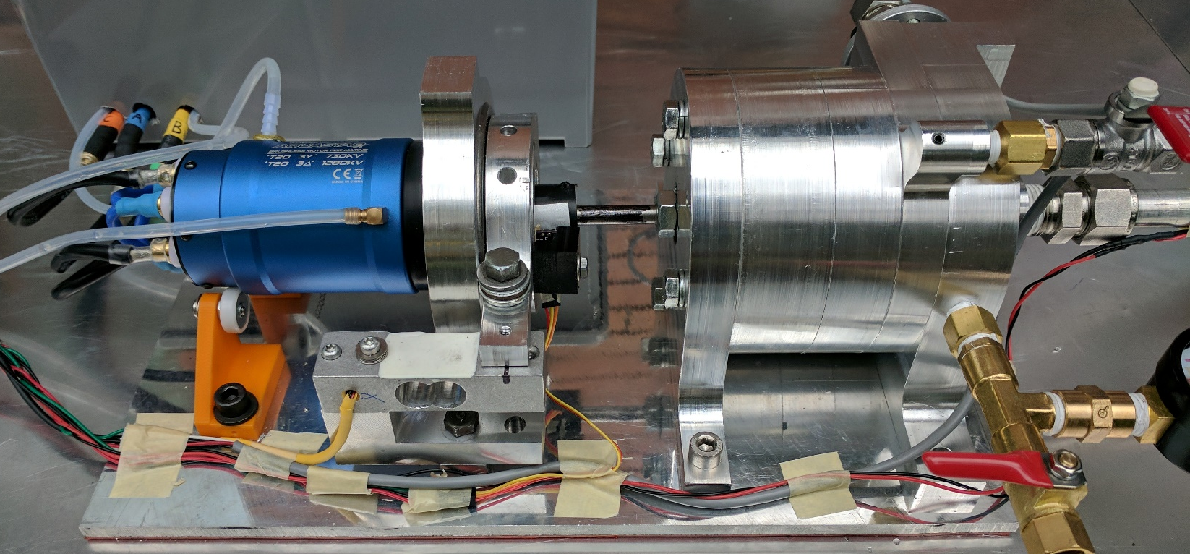

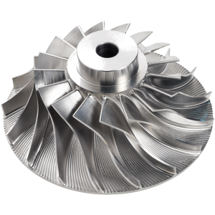
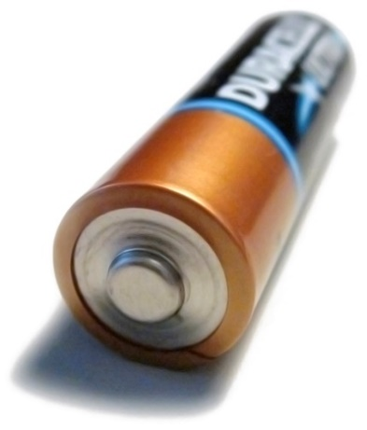
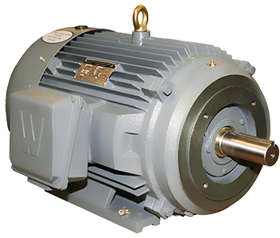
New approach: electric pump
Turbopump without turbine = just a pump.
Battery energy density has been rising.
Lighter than pressure fed, simpler than turbopump.
https://en.wikipedia.org/
http://www.blue-sky-technologies.com/impeller-seal-repair/
http://www.worldwideelectric.net/

Slide 7
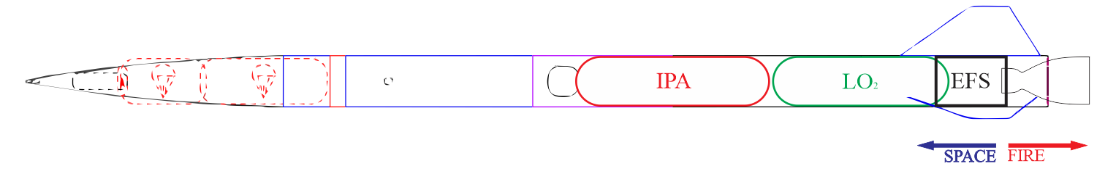
Project Goal
Goal:
Design a test pump to try to meet PSAS’ requirements (~400 psi at 12 gpm)
Test with water (not cryogenic liquid oxygen and isopropyl alcohol).
Performance results will be scaled to design actual rocket pump.

